Slide 1
Giellatekno XML
And MediaWiki

Slide 2
XML dictionaries
Difficult to edit
Validation
Edits by multiple users?

Slide 3
XML dictionaries
Difficult to edit
Validation
Edits by multiple users?

Slide 4
MediaWiki
Easy to use
Support for multiple users
Input can be validated immediately (form)

Slide 5
MediaWiki
Easy to use
Support for multiple users
Input can be validated immediately (form)

Slide 6
XML still needed
Edits in XML
Edits in MediaWiki
Synchronization?

Slide 7
XML still needed
Edits in XML
Edits in MediaWiki
Synchronization?

Slide 8
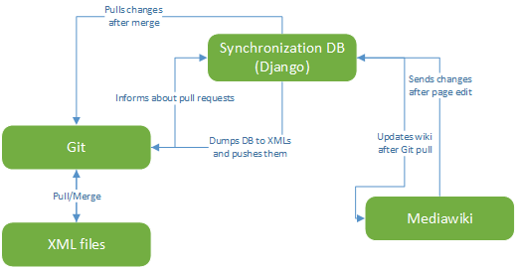

Slide 13
Last slide!

Slide 14
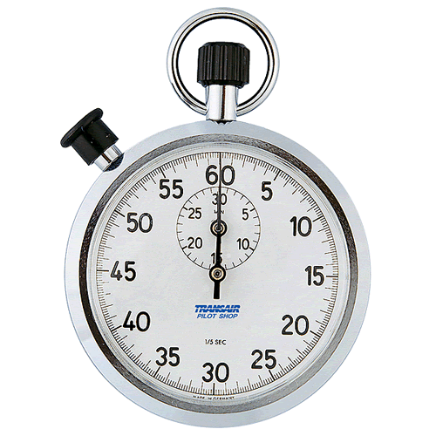
Time’s Up!
About your speaker:
  Name: Mika Hämäläinen
  Institution: University of Helsinki
  Website: http://mikakalevi.com
  Quick bio: PhD student in language technology. Background in computer science. MA degree in Spanish philology.

